Slide 1
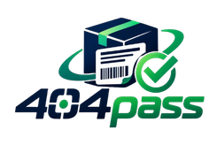




SMART INDIA HACKATHON 2026
Problem Statement ID - SIH26034
Problem Statement Title - Software System to check compliance of Packaged Commodities under Legal Metrology(Packaged Commodities) Rules, 2011 by scanning products, images and labels.
Theme -Miscellaneous
PS Category - Software
Team ID -
Team Name - 404pass
Problem
Mandatory label declarations are required under the Legal Metrology (Packaged Commodities) Rules, 2011.
Missing/incomplete declarations are common due to design & printing oversights.
Manual checking is slow, inconsistent, and rule-dependent.
Non-compliance can lead to penalties and costly corrections after printing.
No simple self-serve pre-print verification tool exists.

Slide 2
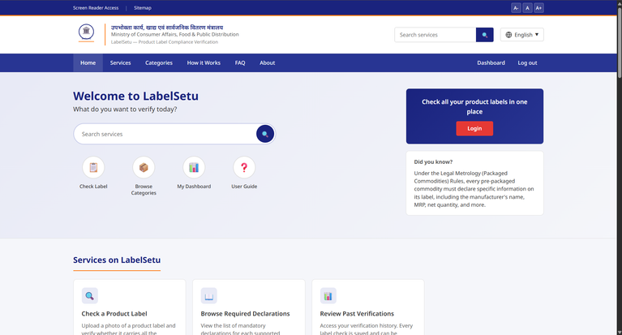

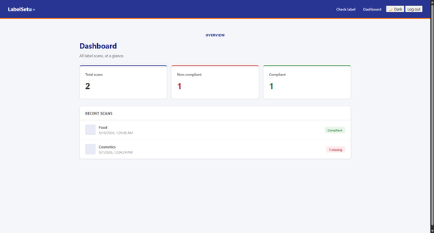
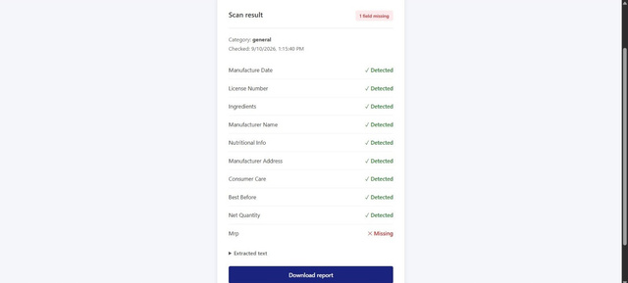
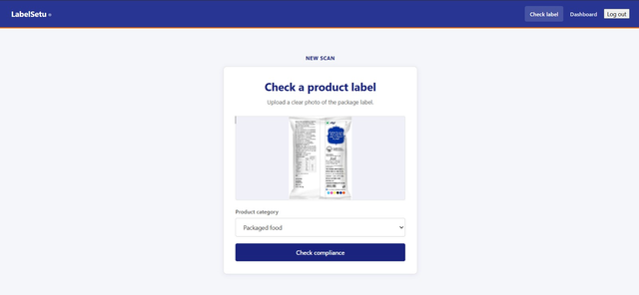
LabelSetu
THEORY / WORKING PRINCIPLE
LabelSetu works on the principle of Automated Label Information Extraction and Rule-Based Compliance Verification.
Image Acquisition
A product label is captured/uploaded as an image.
Text & Field Extraction
OCR extracts the textual information from the label and identifies important fields such as MRP, net quantity, manufacturer details, consumer care information, etc.
Category-Based Rule Mapping
The selected product category determines the set of mandatory declarations required under the Legal Metrology (Packaged Commodities) Rules, 2011.
Compliance Comparison
The extracted fields are compared with the required fields using a rule-based compliance engine.
Missing Declaration Detection
The system identifies which mandatory declarations are present and which are missing.
Compliance Result & Report
The result is presented as a Pass/Fail status with a Found vs. Missing breakdown, along with a verification report.
Core Principle:
Label Image → Information Extraction → Rule Mapping → Required vs. Detected Comparison → Compliance Result
Key Advantage:
The rule engine is independent of the OCR technology, allowing the system to improve its text-extraction method without changing the compliance logic.
2

Slide 3
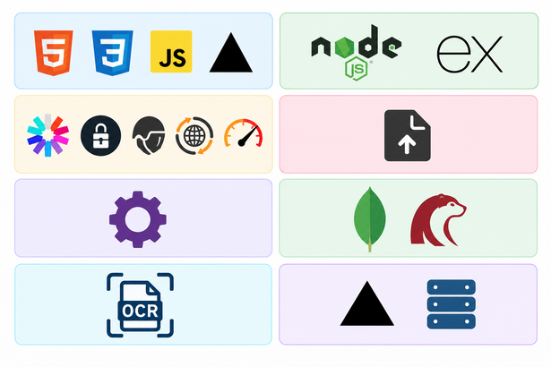
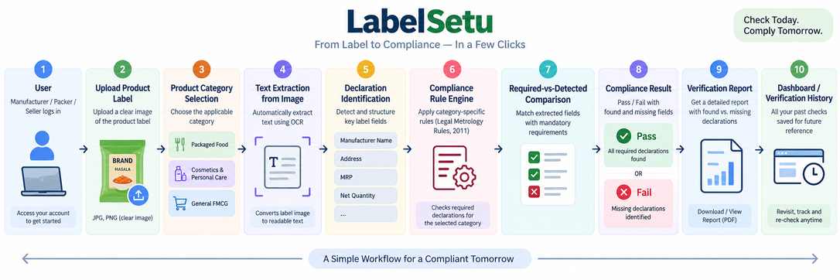
Technical Approach
TECHNOLOGY STACK
Frontend : HTML5 • CSS3 • Vanilla JavaScript • Vercel
Backend : Node.js • Express.js
Authentication & Security : JWT • bcryptjs • Helmet • CORS • express-rate-limit
File Handling : Multer
Compliance Engine : Custom Node.js Rule Engine
Database : MongoDB • Mongoose (integration-ready)
OCR / Text Extraction : OCR Service Interface (engine integration pending)
Deployment : Vercel • Backend Platform (TBD)
WORKFLOW:
3

Slide 4
FEASIBILITY AND VIABILITY
Feasibility:
Technical:
Feasible using established technologies such as OCR, Node.js, Express.js, and rule-based processing to automate label verification.
Economic:
Cost-effective through open-source technologies and free-tier development platforms, reducing initial infrastructure and licensing expenses.
Operational:
Simple workflow requiring only a product-label image and category selection, making the system easy for manufacturers, packers, and sellers to use.
Challenges:
OCR Accuracy:
Poor image quality, small text, curved packaging, or low contrast may affect text extraction accuracy.
Regulatory Changes:
Changes in Legal Metrology requirements require the rule sets to be regularly updated.
False Results:
Incorrect field detection may lead to false positives or negatives, so the system is designed as a self-checking aid rather than official legal certification.
Solutions:
Clear Image Guidance:
Guide users to upload well-lit, straight and readable label images.
Modular Rule Engine:
Maintain category-specific requirements separately so regulatory updates can be implemented easily.
Expandable Architecture:
Support additional categories, multilingual OCR, bulk verification and enterprise/API integration in future versions.
User-Friendly Design:
Provide a clear Found vs. Missing result and structured verification report for quick decision-making.
Viability:
Market Opportunities:
Large potential user base among manufacturers, packers, sellers, and compliance teams dealing with pre-packaged commodities in India.
Scalability:
The category-based rule structure allows new product categories and declaration requirements to be added without redesigning the core system.
Sustainability & Future-Proofing:
The modular architecture allows OCR, database, and compliance rules to be independently upgraded as technology and regulations evolve.
4

Slide 5
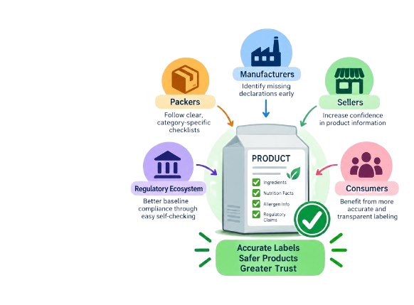
IMPACT AND BENEFITS
Benefits of the Solution
Potential Impact on the Target Audience
Manufacturers: Identify missing declarations before printing and distribution.
Packers: Follow a clear, category-specific checklist without manually searching through rules.
Sellers: Improve confidence that products contain the required label information.
Compliance Teams: Maintain a repeatable and auditable verification workflow.
Regulatory Ecosystem: Encourages better baseline compliance through easier self-checking.
Consumers: Benefit indirectly from more accurate and transparent product labeling.
Social:
Improves transparency between manufacturers and consumers.
Promotes more accurate and consistently compliant product labels.
Reduces dependence on manual and error-prone verification.
Technological:
Automates label information extraction and compliance checking.
Uses a rule-based engine for category-specific verification.
Provides digital verification reports and saved verification history.
Economic:
Reduces manual effort involved in checking product labels.
Helps identify missing declarations before printing or distribution, reducing correction costs.
Enables a faster and repeatable compliance workflow.
Regulatory / Governance:
Helps manufacturers and sellers self-assess labels against known requirements.
Makes category-specific declaration requirements easier to understand.
Maintains a structured record of previous verifications.
5

Slide 6

RESEARCH AND REFERENCES
Legal & Regulatory Research
The solution is based on the Legal Metrology (Packaged Commodities) Rules, 2011, which specify mandatory declarations for pre-packaged commodities.
Key declarations include manufacturer/packer/importer details, commodity name, net quantity, MRP, country of origin, applicable date information, and consumer-care details.
The Department of Consumer Affairs – Legal Metrology Portal provides official information and services related to packaged commodities and Rule 27 registration.
Technology Research
OCR / Text Extraction: Used as the foundation for converting product-label images into machine-readable information.
Rule-Based Verification: Extracted information is compared with category-specific mandatory declarations.
Modular Architecture: OCR, database, and compliance rules are designed as independent components, allowing future upgrades without redesigning the complete system.
Primary References
Legal Metrology Portal — Department of Consumer Affairs : https://lm.doca.gov.in/
Department of Consumer Affairs — Government of India: https://consumeraffairs.gov.in/
Legal Metrology (Packaged Commodities) Rules, 2011 Official regulatory framework used for defining mandatory label declarations.
National Portal of India National Portal of India : https://www.india.gov.in/
National Consumer Helpline — Government of India National Consumer Helpline : https://consumerhelpline.gov.in/public/
6

